Slide 1

IPL AUCTION ANALYSIS By- Saptarag Kashyap

Slide 2
CREATE TABLE QUERIES
1) IPL_BALL Table
CREATE TABLE IPL_ball (
id INT,
inning INT,
over INT,
ball INT,
batsman VARCHAR(255),
non_striker VARCHAR(255),
bowler VARCHAR(255),
batsman_runs INT,
extra_runs INT,
total_runs INT,
is_wicket INT,
dismissal_kind VARCHAR(255),
player_dismissed VARCHAR(255),
fielder VARCHAR(255),
extras_type VARCHAR(255),
batting_team VARCHAR(255),
bowling_team VARCHAR(255)
);
1) IPL_Matches Table
CREATE TABLE IPL_matches (
id INT,
city VARCHAR(255),
date DATE,
player_of_match VARCHAR(255),
venue VARCHAR(255),
neutral_venue INT,
team1 VARCHAR(255),
team2 VARCHAR(255),
toss_winner VARCHAR(255),
toss_decision VARCHAR(255),
winner VARCHAR(255),
result VARCHAR(255),
result_margin VARCHAR(255),
eliminator VARCHAR(255),
method VARCHAR(255),
umpire1 VARCHAR(255),
umpire2 VARCHAR(255)
);

Slide 3
COPY COMMAND QUERIES
1) Copy command query for IPL_Ball
Table to insert data--
copy IPL_ball from 'C:\Program Files\PostgreSQL\16\data\IPL_Ball.csv' delimiter ',' csv header;
Check using Select Query--
select * from IPL_Ball;
1) Copy command query for IPL_Matches Table to insert data--
copy IPL_matches from 'C:\Program Files\PostgreSQL\16\data\IPL_matches.csv' delimiter ',' csv header;
Check using Select Query--
select * from IPL_Matches;

Slide 4
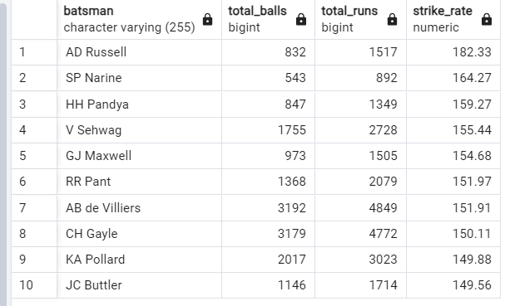
TASK 1 Your first priority is to get 2-3 players with high S.R who have faced at least 500 balls.And to do that you have to make a list of 10 players you want to bid in the auction so that when you try to grab them in auction you should not pay the amount greater than you have in the purse for a particular player.
QUERY USED--
Select batsman,count(ball) as total_balls,
sum(batsman_runs) as total_runs,
round(cast(sum(batsman_runs) as decimal)/count(ball) * 100,2) as strike_rate
from IPL_Ball
where not (extras_type='wides')
group by batsman
having count(ball)>=500
order by strike_rate desc
limit 10;
OUTPUT—

Slide 5
TASK-1

Slide 6
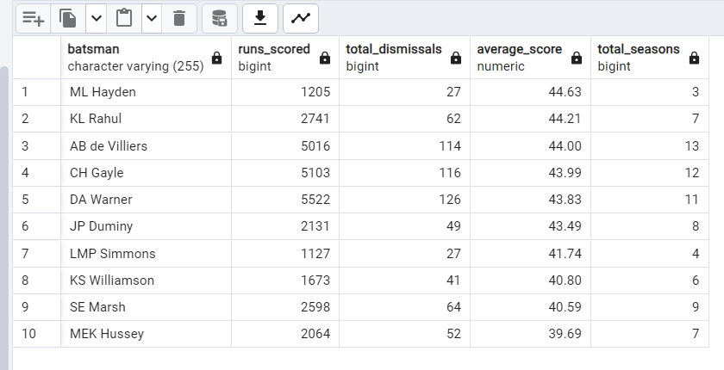
TASK-2 You need to get 2-3 players with good Average who have played more the 2 ipl seasons.And to do that you have to make a list of 10 players you want to bid in the auction so that when you try to grab them in auction you should not pay the amount greater than you have in the purse for a particular player.
QUERY USED—
select a.batsman,sum(a.total_runs) as runs_scored,
sum(a.is_wicket) as total_dismissals,
round(cast(sum(a.total_runs)as decimal)/sum(a.is_wicket),2) as average_score,
COUNT(DISTINCT EXTRACT(YEAR FROM m.date)) AS total_seasons
from IPL_Ball as a
join IPL_matches as m
on a.id=m.id
group by a.batsman
having (sum(a.is_wicket)>=1 and COUNT(DISTINCT a.id) > 28)
order by average_score desc
Limit 10;
OUTPUT—

Slide 7
TASK-2

Slide 8
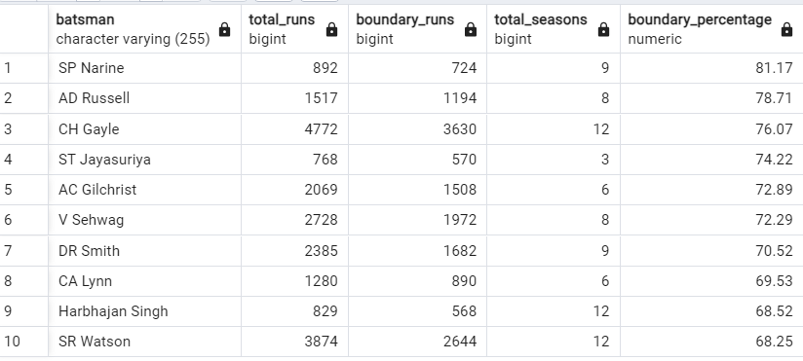
TASK-3 You need to get 2-3 Hard-hitting players who have scored most runs in boundaries and have played more than 2 ipl season. To do that you have to make a list of 10 players you want to bid in the auction so that when you try to grab them in auction you should not pay the amount greater than you have in the purse for a particular player.
QUERY USED—
select a.batsman,sum(a.batsman_runs) as total_runs,
sum(case when a.batsman_runs=4 then 4 when a.batsman_runs=6 then 6 else 0 end) as boundary_runs,
COUNT(DISTINCT EXTRACT(YEAR FROM b.date)) AS total_seasons,
round(sum(case when a.batsman_runs=4 then 4 when a.batsman_runs=6 then 6 else 0 end)*1.0/sum(a.batsman_runs)*100,2) as boundary_percentage
from IPL_ball as a left join IPL_matches as b
on a.id=b.id
group by batsman
having (COUNT(DISTINCT a.id) > 28)
order by boundary_percentage desc limit 10;
OUTPUT—

Slide 9
TASK-3

Slide 10
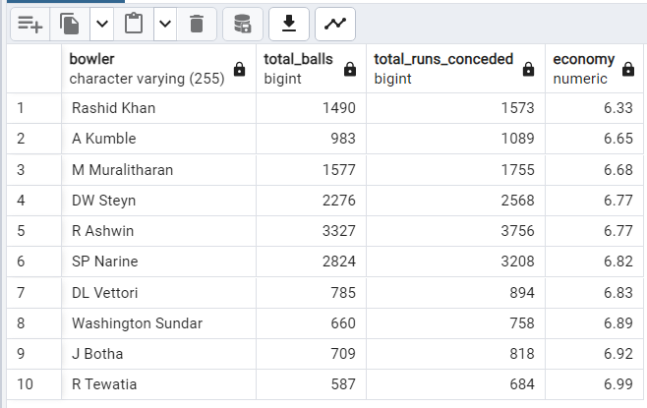
TASK-4 Your first priority is to get 2-3 bowlers with good economy who have bowled at least 500 balls in IPL so far.To do that you have to make a list of 10 players you want to bid in the auction so that when you try to grab them in auction you should not pay the amount greater than you have in the purse for a particular player.
QUERY USED—
SELECT
bowler,
COUNT(*) AS total_balls,
SUM(total_runs) AS total_runs_conceded,
ROUND((SUM(total_runs) * 6.0) / COUNT(*), 2) AS economy
FROM IPL_Ball
GROUP BY bowler
HAVING COUNT(*) >= 500
ORDER BY economy asc
LIMIT 10;
OUTPUT—

Slide 11
TASK-4

Slide 12
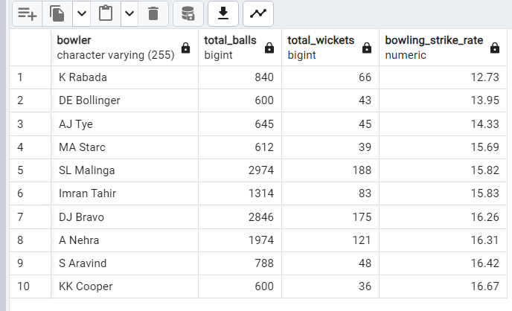
TASK-5 you need to get 2-3 bowlers with the best strike rate and who have bowled at least 500 balls in IPL so far.To do that you have to make a list of 10 players you want to bid in the auction so that when you try to grab them in auction you should not pay the amount greater than you have in the purse for a particular player.
QUERY USED—
SELECT
bowler,
COUNT(*) AS total_balls,
SUM(CAST(is_wicket AS INT)) AS total_wickets,
ROUND(cast(count(*) as decimal)/sum(is_wicket),2) as bowling_strike_rate
FROM IPL_ball
GROUP BY bowler
HAVING COUNT(*) >= 500
ORDER BY bowling_strike_rate asc
LIMIT 10;
OUTPUT—

Slide 13
TASK-5

Slide 14
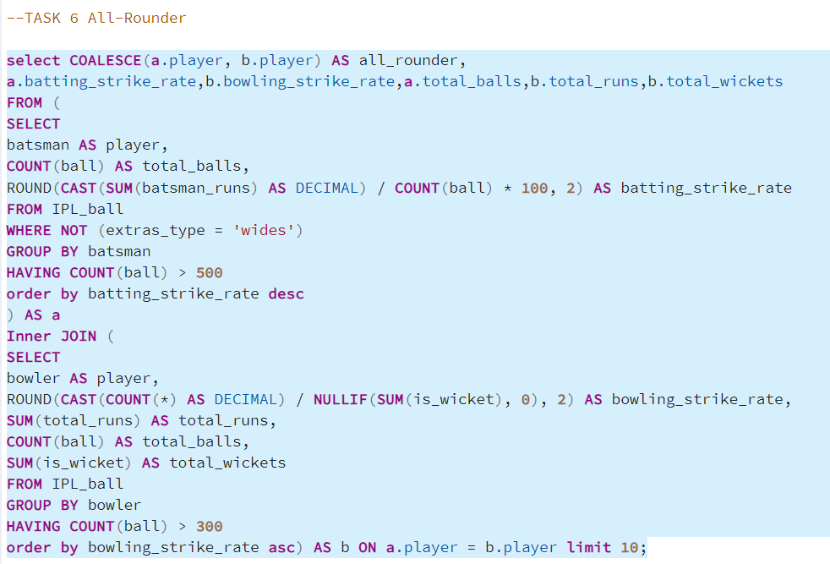
TASK-6 you need to get 2-3 All_rounders with the best batting as well as bowling strike rate and who have faced at least 500 balls in IPL so far and have bowled minimum 300 balls.To do that you have to make a list of 10 players you want to bid in the auction so that when you try to grab them in auction you should not pay the amount greater than you have in the purse for a particular player. USED QUERY

Slide 15
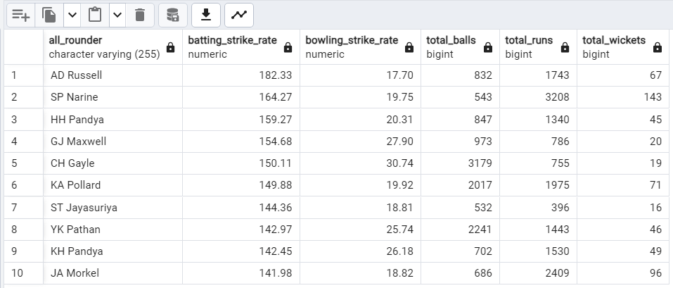
TASK-6 OUTPUT

Slide 16
TASK-6

Slide 17
TASK -7 WICKET-KEEPER CRITERIA 1)Batting Strike-rate- Wicket-keepers with high batting strike rate in the final overs, scoring quickly is essential 2)Aggressive batting - Wicket-keepers who playes attacking shots/power-hitting to help quicky moves the score-card 3)Experience- Wicket-keepers having a good experience in T-20 format or having played more than 2-3 seasons 4)Wicket-keeping skills- Having good skills including stumpings and catching, quick reflexes 5)Decision-making - Good understanding and decision making skills to help the captains making right decisions during review system(DRS) as he can asses behind the stumps(like LBW/Catches). 6)Bowling- Sometims they can chip in with 1-2 overs with their bowling with some spin oe medium pace which adds to the teams bowling options

Slide 18
Additonal Questions Create tables query
1) Creating the Deliveries Table from IPL
Ball table
Used Query—
CREATE TABLE Deliveries AS
SELECT * FROM IPL_Ball;
2) Creating the Matches Table from IPL
Matches table
Used Query—
CREATE TABLE Matches AS
SELECT * FROM IPL_Matches;

Slide 19
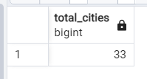
Q-1 Get the count of cities that have hosted an IPL match.
USED QUERY—
SELECT COUNT(DISTINCT city) AS total_cities
FROM matches;
OUTPUT—

Slide 20
Q-2 Create table deliveries_v02 with all the columns of the table ‘deliveries’ and an additional column ball_result containing values boundary, dot or other depending on the total_run (boundary for >= 4, dot for 0 and other for any other number)
USED QUERY—
CREATE TABLE deliveries_v02 AS
SELECT *,
CASE
WHEN total_runs >= 4 THEN 'boundary'
WHEN total_runs = 0 THEN 'dot'
ELSE 'other'
END AS ball_result
FROM deliveries;
Note-
As the table is too big I have just shared the create table query for deliveries_v02 .
Check with select Query—
select * from deliveries_v02;

Slide 21
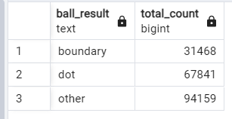
Q-3 Write a query to fetch the total number of boundaries and dot balls from the deliveries_v02 table.
USED QUERY—
SELECT
ball_result,
COUNT(*) AS total_count
FROM
deliveries_v02
GROUP BY
ball_result;
OUTPUT—

Slide 22
Q-3 Write a query to fetch the total number of boundaries and dot balls from the deliveries_v02 table.

Slide 23
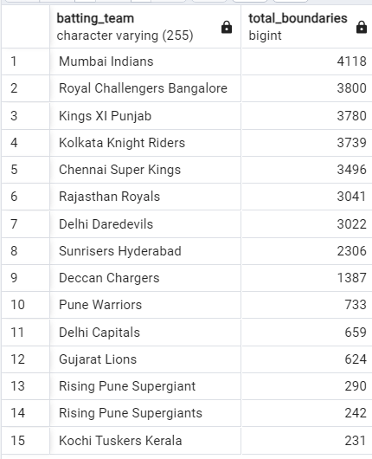
Q-4 Write a query to fetch the total number of boundaries scored by each team from the deliveries_v02 table and order it in descending order of the number of boundaries scored.
USED QUERY—
SELECT
batting_team,
COUNT(*) AS total_boundaries
FROM
deliveries_v02
WHERE
ball_result = 'boundary'
GROUP BY
batting_team
ORDER BY
total_boundaries DESC;
OUTPUT—

Slide 24
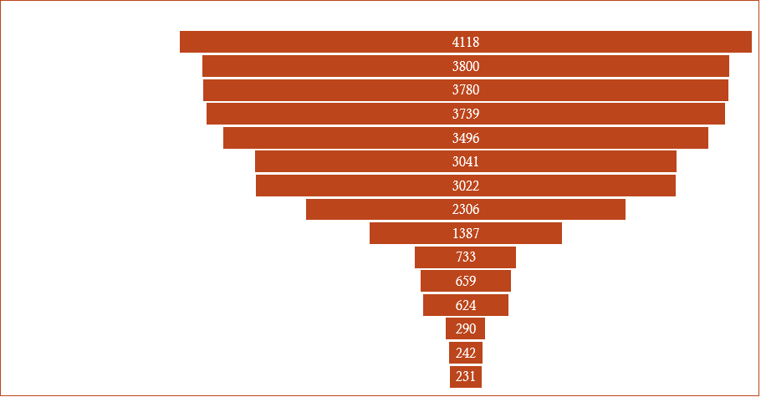
Q-4 Write a query to fetch the total number of boundaries scored by each team from the deliveries_v02 table and order it in descending order of the number of boundaries scored.

Slide 25
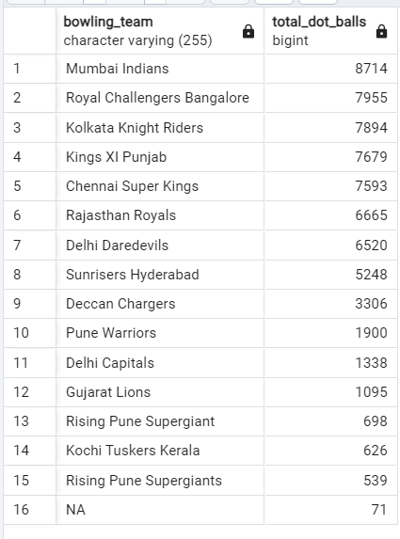
Q-5 Write a query to fetch the total number of dot balls bowled by each team and order it in descending order of the total number of dot balls bowled.
USED QUERY—
SELECT
bowling_team,
COUNT(*) AS total_dot_balls
FROM
deliveries_v02
WHERE
ball_result = 'dot'
GROUP BY
bowling_team
ORDER BY
total_dot_balls DESC;
OUTPUT—

Slide 26
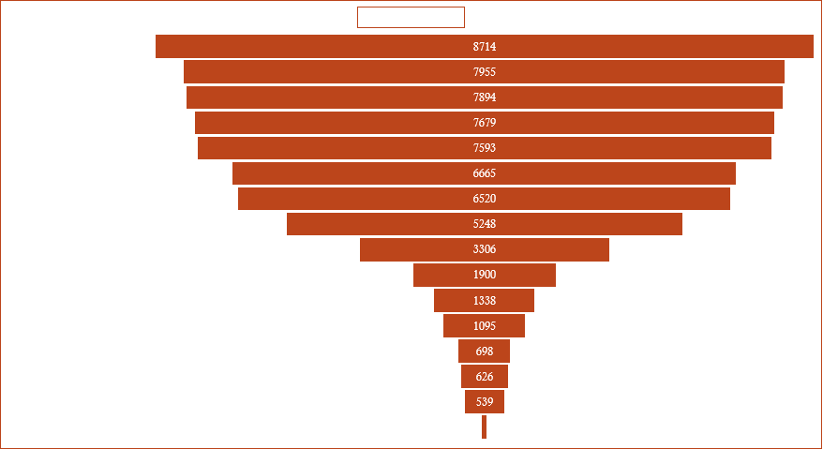
Q-5 Write a query to fetch the total number of dot balls bowled by each team and order it in descending order of the total number of dot balls bowled.

Slide 27
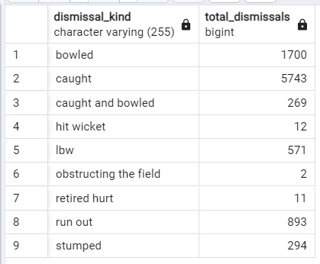
Q-6 Write a query to fetch the total number of dismissals by dismissal kinds where dismissal kind is not NA
USED QUERY—
SELECT
dismissal_kind,
COUNT(*) AS total_dismissals
FROM
deliveries_v02
WHERE
dismissal_kind IS NOT NULL
AND dismissal_kind <> 'NA'
GROUP BY
dismissal_kind;
OUTPUT—

Slide 28
Q-6 Write a query to fetch the total number of dismissals by dismissal kinds where dismissal kind is not NA

Slide 29
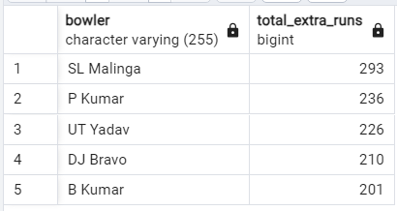
Q-7 Write a query to get the top 5 bowlers who conceded maximum extra runs from the deliveries table
USED QUERY—
SELECT
bowler,
SUM(extra_runs) AS total_extra_runs
FROM
deliveries
GROUP BY
bowler
ORDER BY
total_extra_runs DESC
LIMIT 5;
OUTPUT—

Slide 30
Q-7 Write a query to get the top 5 bowlers who conceded maximum extra runs from the deliveries table

Slide 31
Q-8 Write a query to create a table named deliveries_v03 with all the columns of deliveries_v02 table and two additional column (named venue and match_date) of venue and date from table matches
USED QUERY—
CREATE TABLE deliveries_v03 AS
SELECT
a.*,
m.venue,
m.date AS match_date
FROM
deliveries_v02 as a
JOIN
matches m ON a.id = m.id;
Note-
As the table is too big I have just shared the create table query for deliveries_v03 .
Check with select Query—
select * from deliveries_v03;

Slide 32
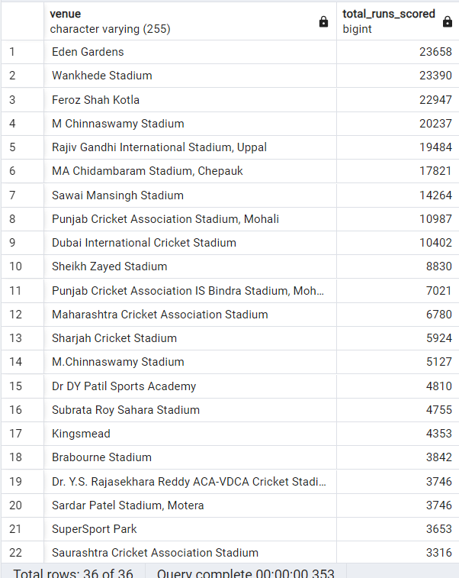
Q-9 Write a query to fetch the total runs scored for each venue and order it in the descending order of total runs scored.
USED QUERY—
SELECT
venue,
SUM(total_runs) AS total_runs_scored
FROM
deliveries_v03
GROUP BY
venue
ORDER BY
total_runs_scored DESC;
OUTPUT—

Slide 33
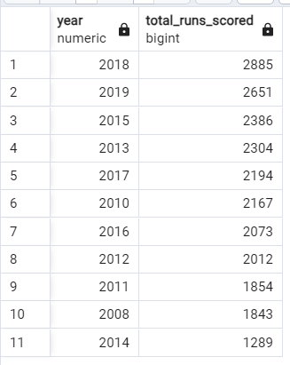
Q-10 Write a query to fetch the year-wise total runs scored at Eden Gardens and order it in the descending order of total runs scored.
USED QUERY—
SELECT
EXTRACT(YEAR FROM match_date) AS year,
SUM(total_runs) AS total_runs_scored
FROM
deliveries_v03
WHERE
venue = 'Eden Gardens'
GROUP BY
year
ORDER BY
total_runs_scored DESC;
OUTPUT—

Slide 34
Q-10 Write a query to fetch the year-wise total runs scored at Eden Gardens and order it in the descending order of total runs scored.

Slide 35
THANK YOU NOTE:I have also added the Query notepad file in the folder that I have used here in analysis.

